Slide 1
Object Oriented System Design (E)
2023 Spring
Final Project
Valorant GAME
Student Name: ARJUN THAPA
Student ID: M22W0385

Slide 2
Contents
Introduction
Use case diagrams
Class and object diagrams
Sequence diagrams
Communication diagrams
State machine diagrams
Activity diagrams
User interface design
Conclusion

Slide 3
Introduction
Valorant combines elements of traditional tactical shooters with unique character-based abilities, similar to hero shooters. In the game, players assume the roles of agents, each with their own distinct abilities and playstyles. The objective varies depending on the game mode, but the most common one is a 5v5 format, where one team plays as attackers trying to plant a bomb called the "Spike," while the other team acts as defenders trying to prevent the Spike from being planted or defuse it if it has been planted.

Slide 4
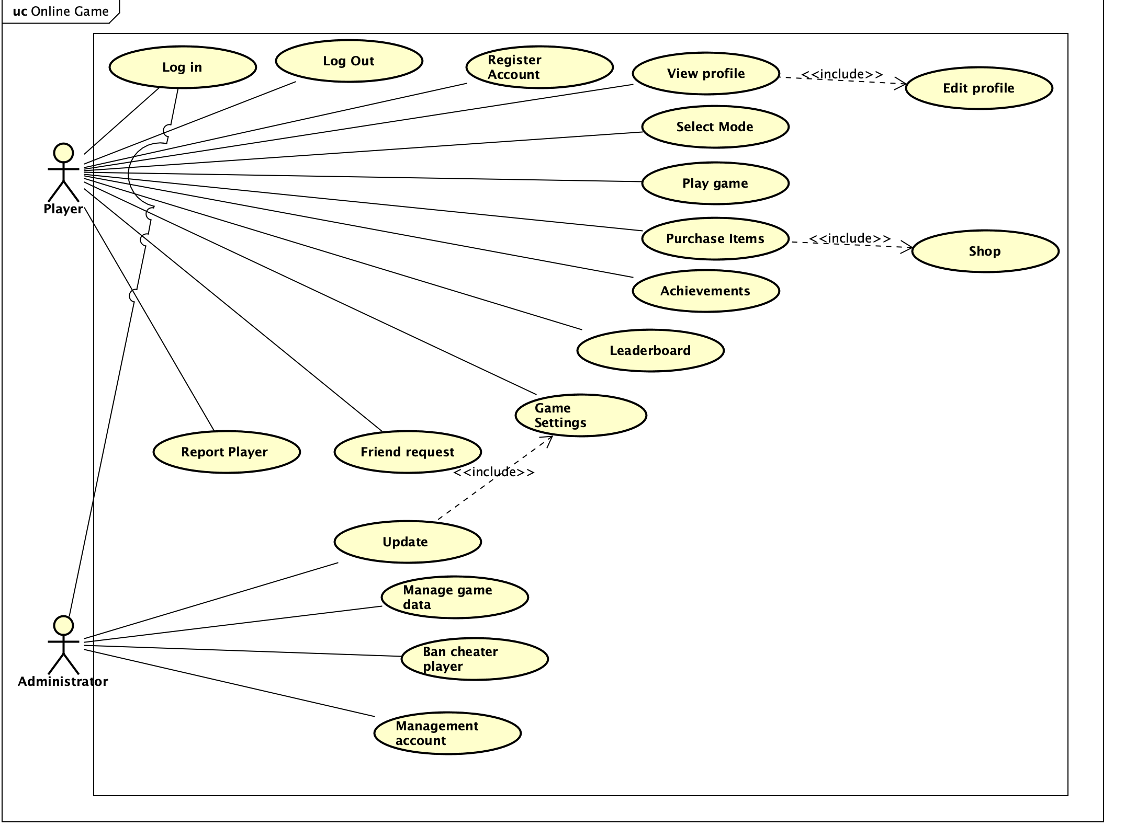
Use case diagrams

Slide 5
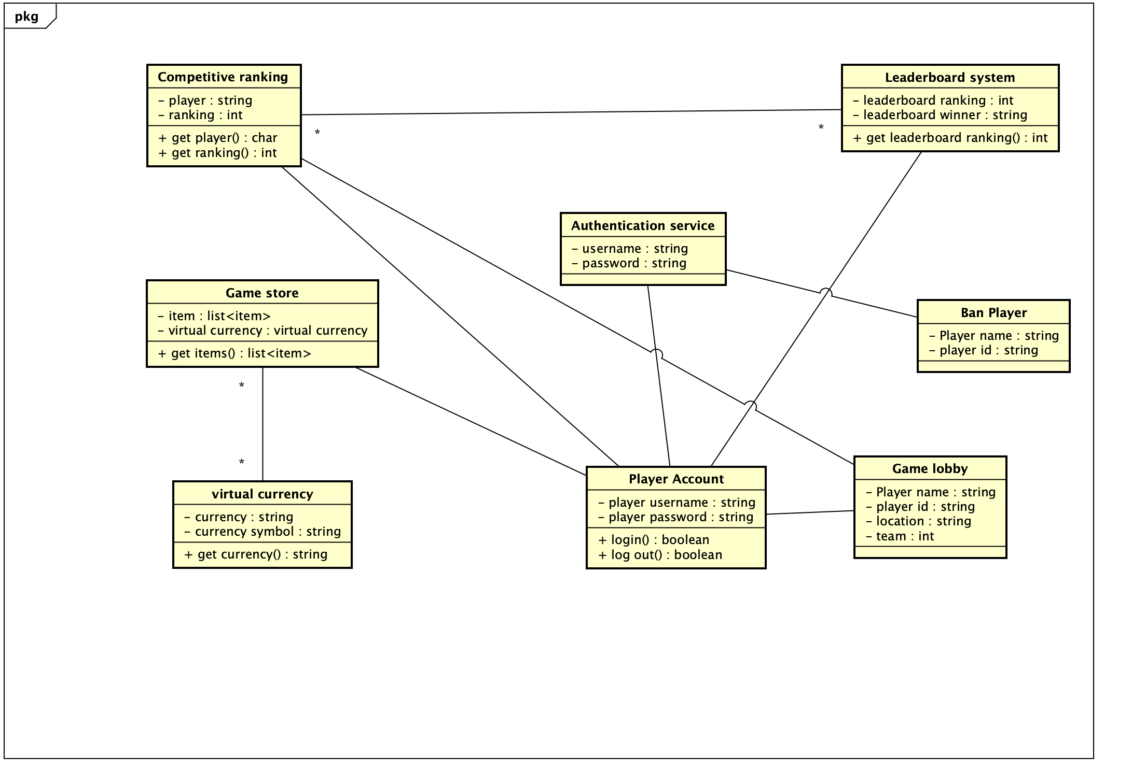
Class and object diagrams

Slide 6
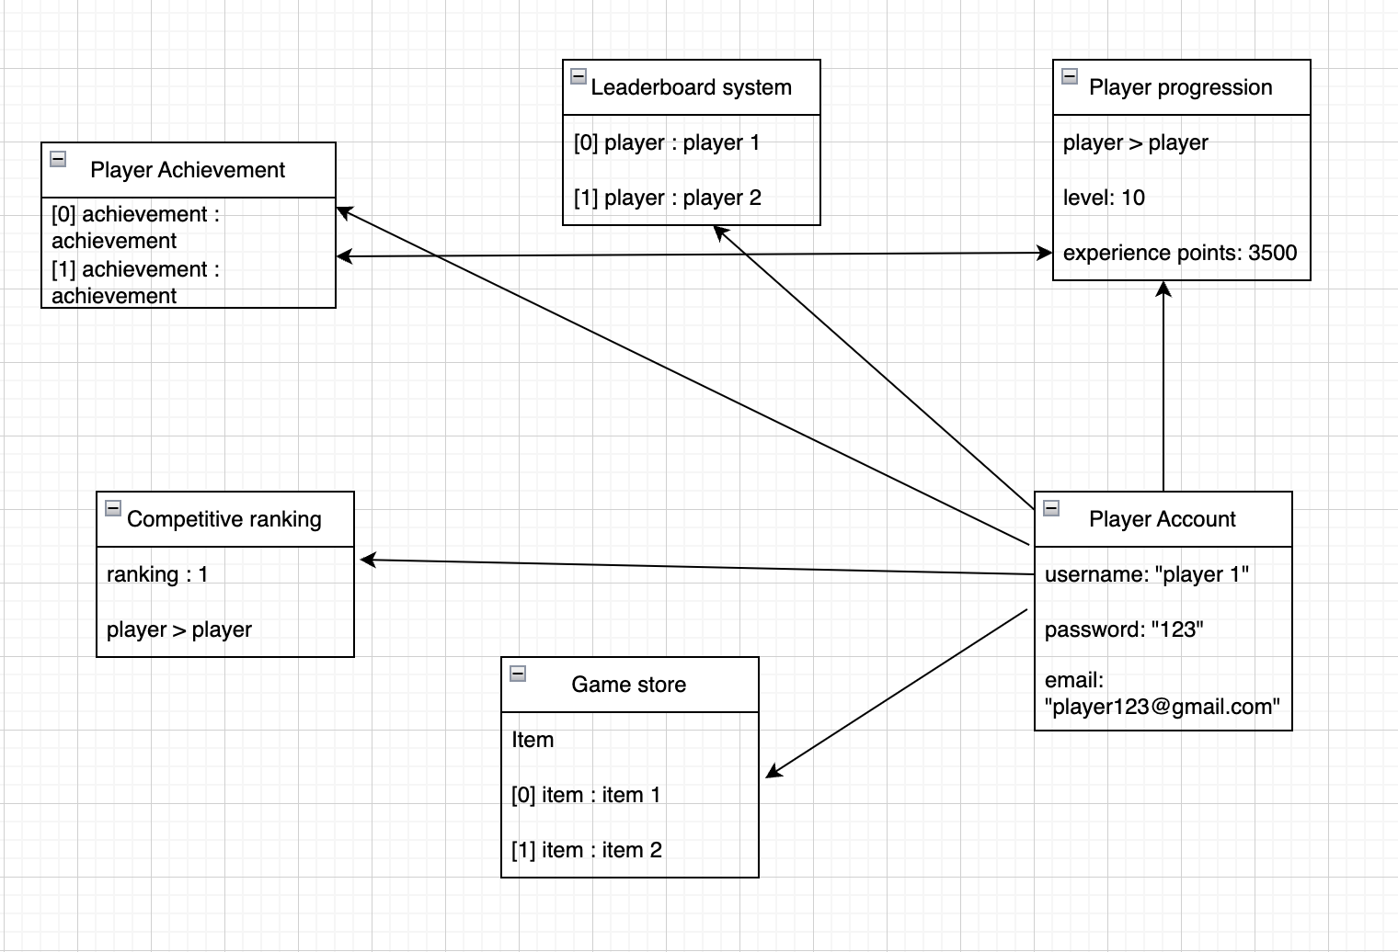
Object diagrams

Slide 7
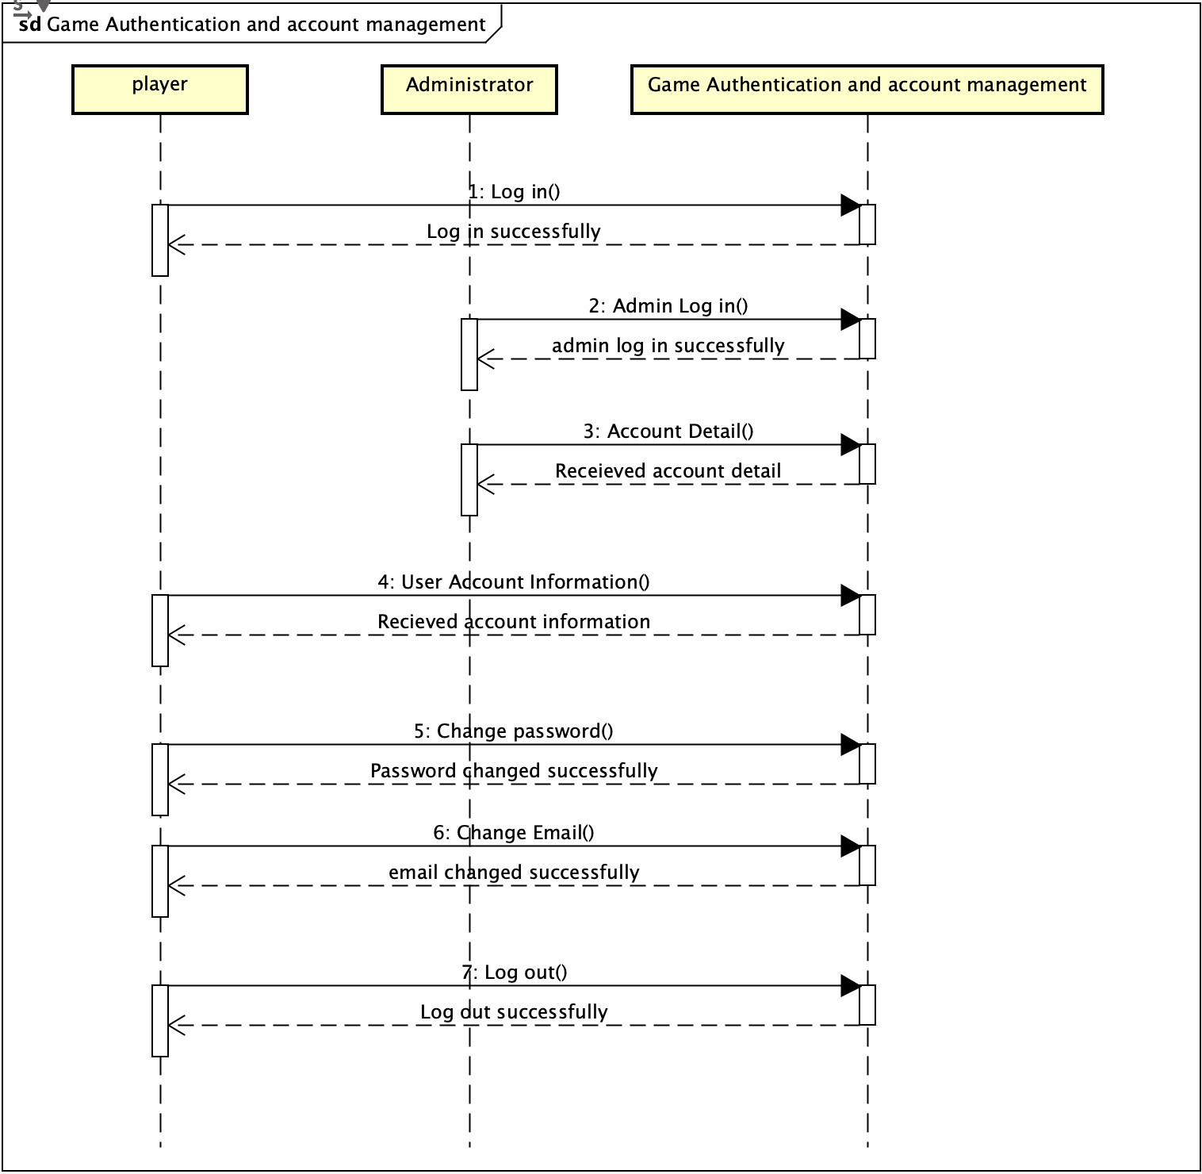
Sequence diagrams

Slide 8
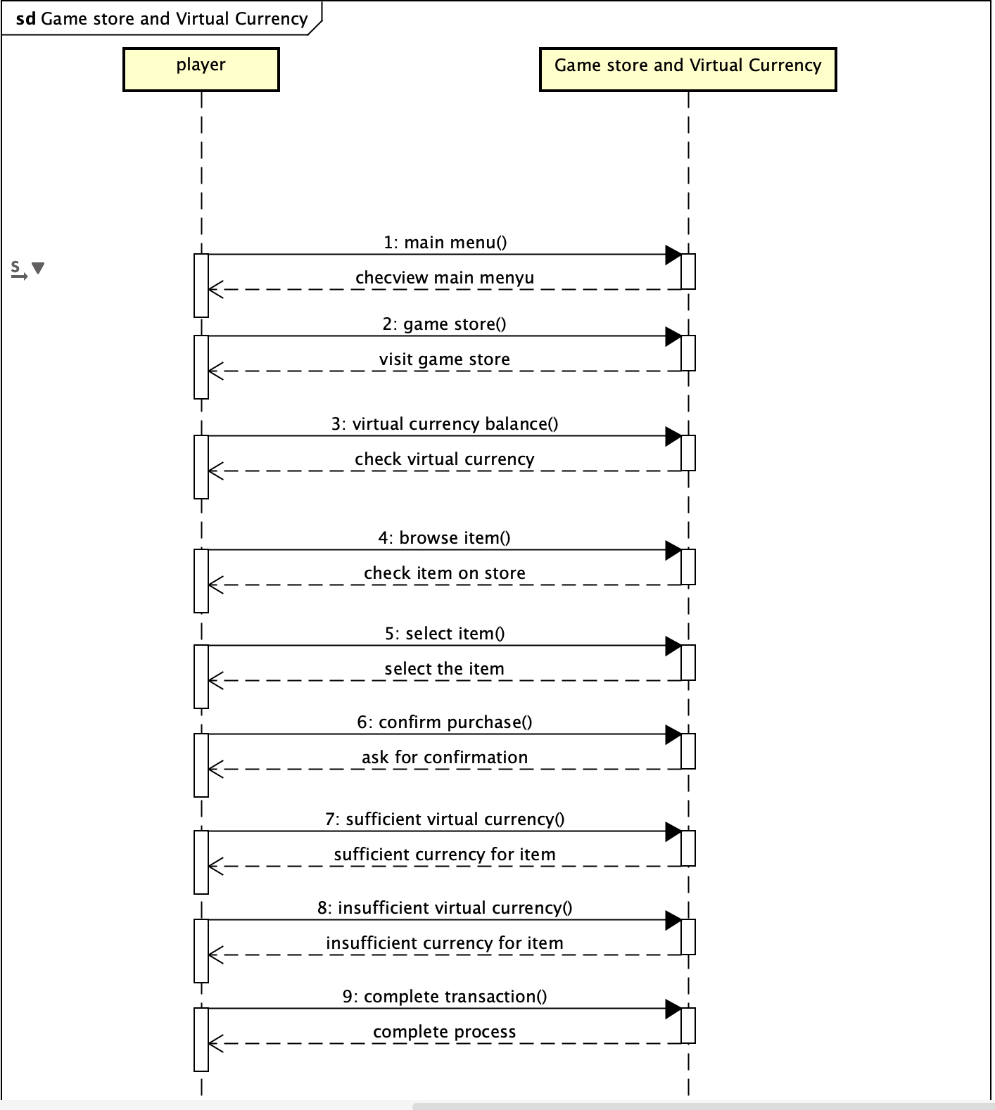
Sequence diagrams

Slide 9
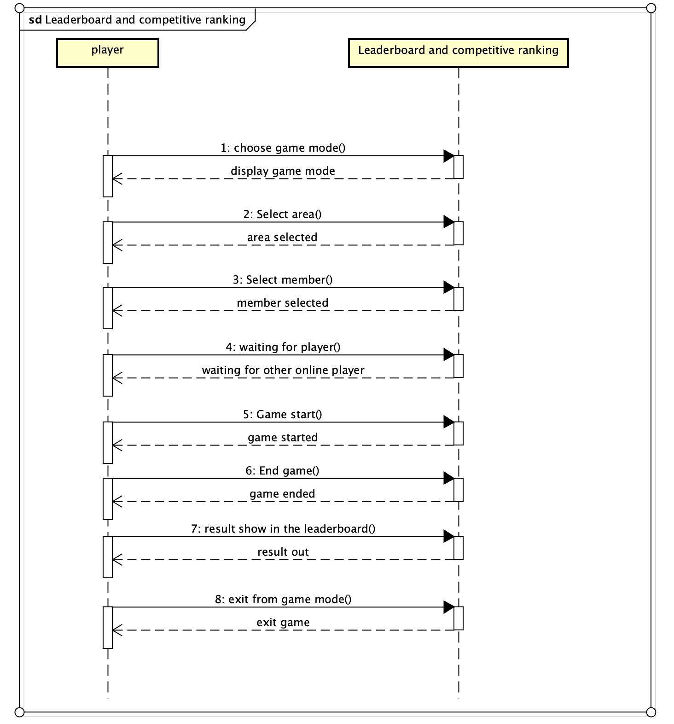
Sequence diagrams

Slide 10
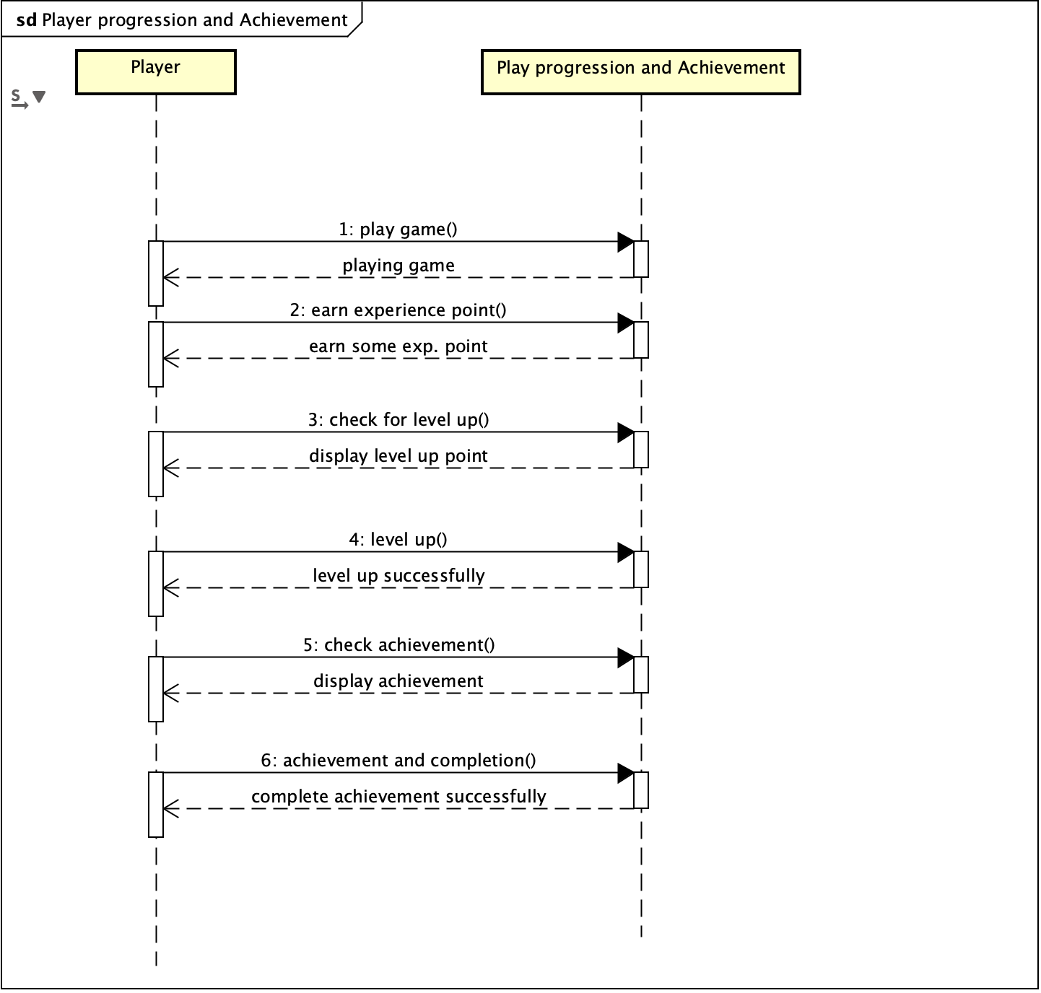
Sequence diagrams

Slide 11
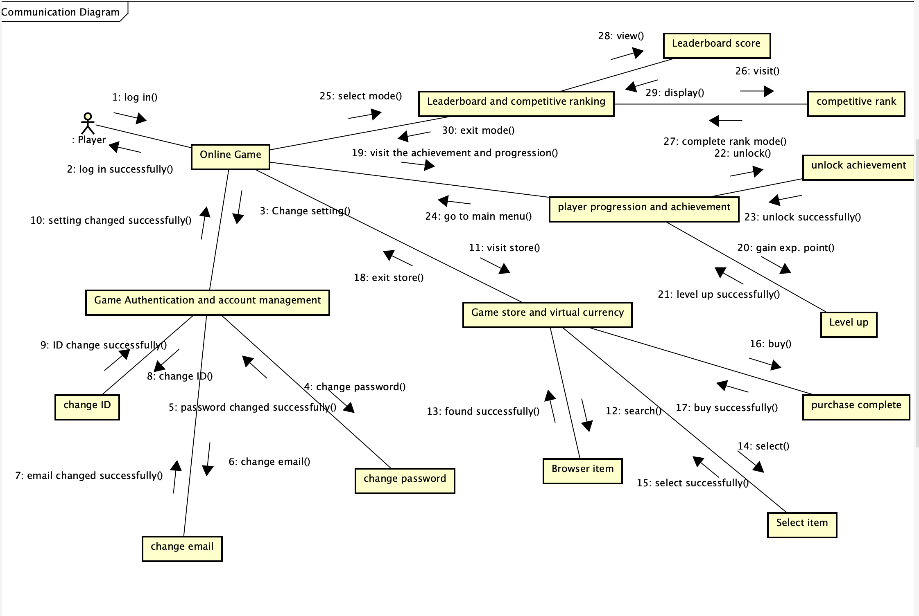
Communication diagrams

Slide 12
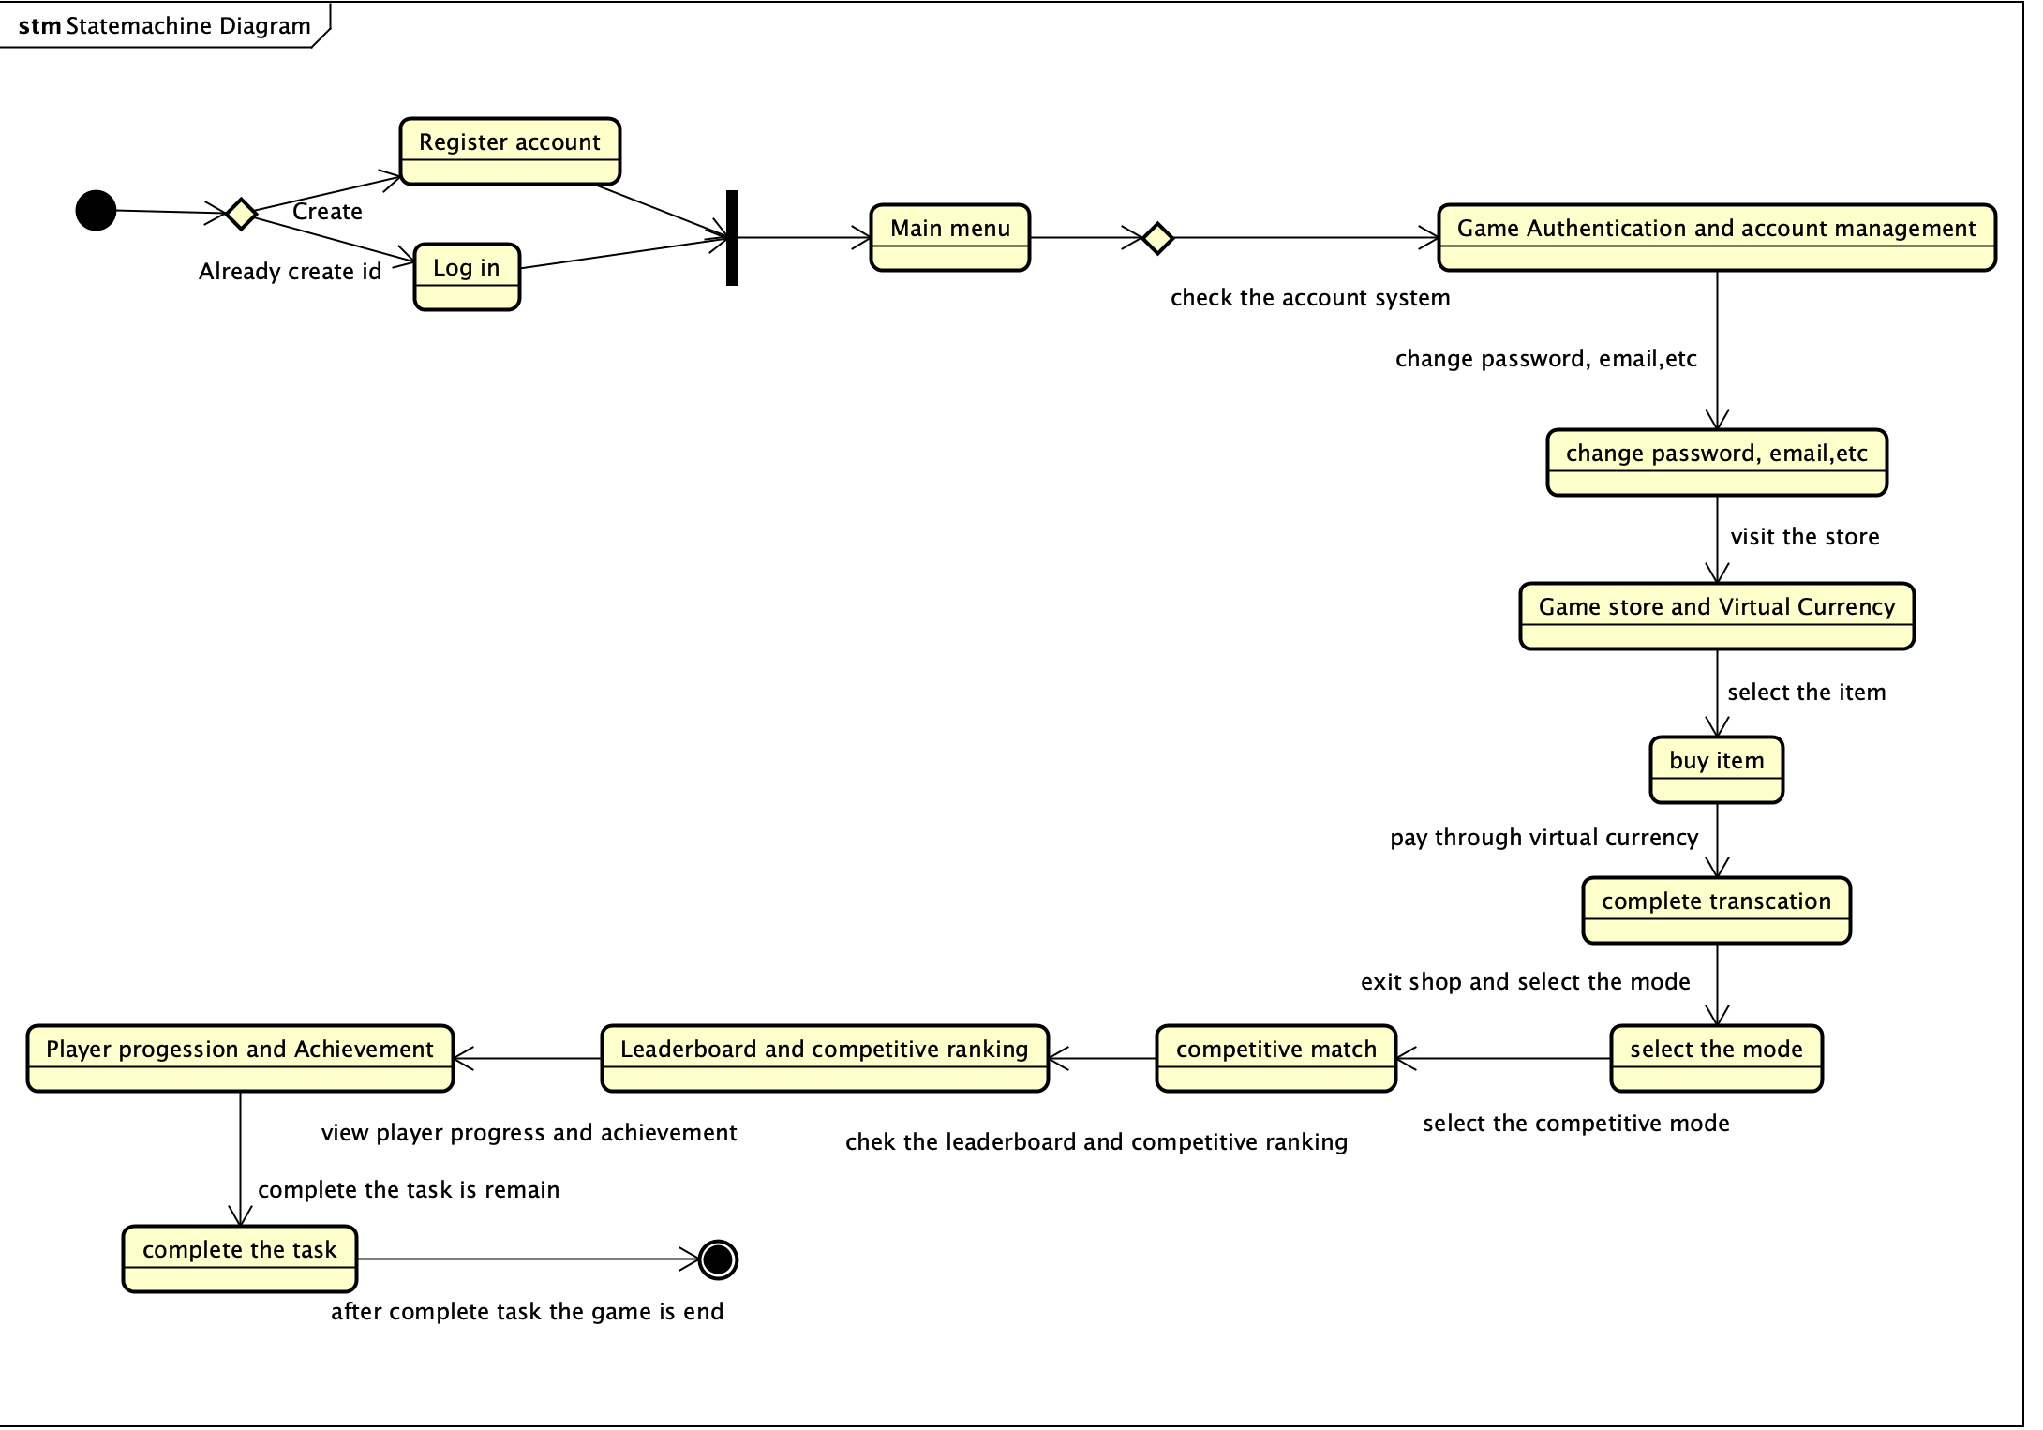
State machine diagrams

Slide 13
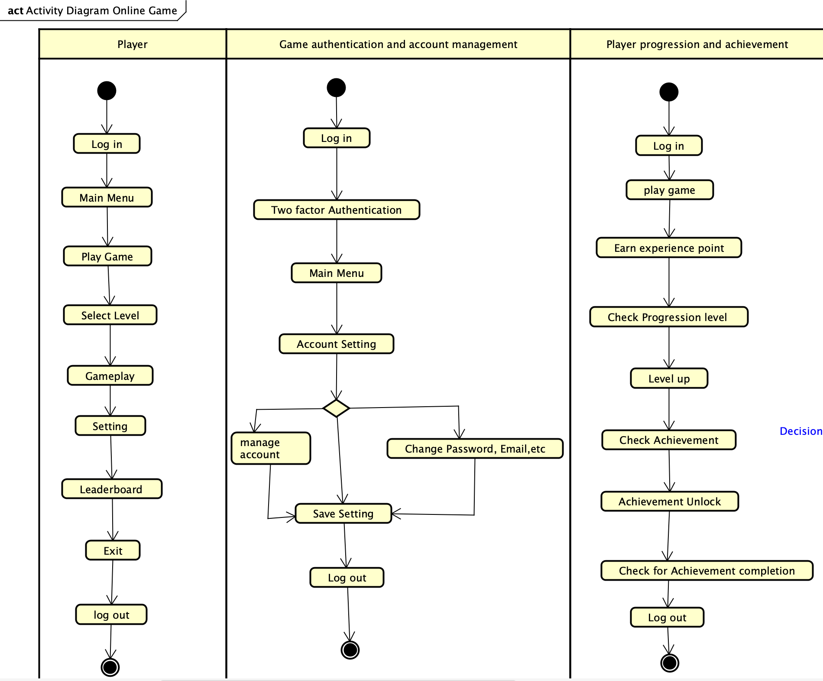
Activity diagrams

Slide 14
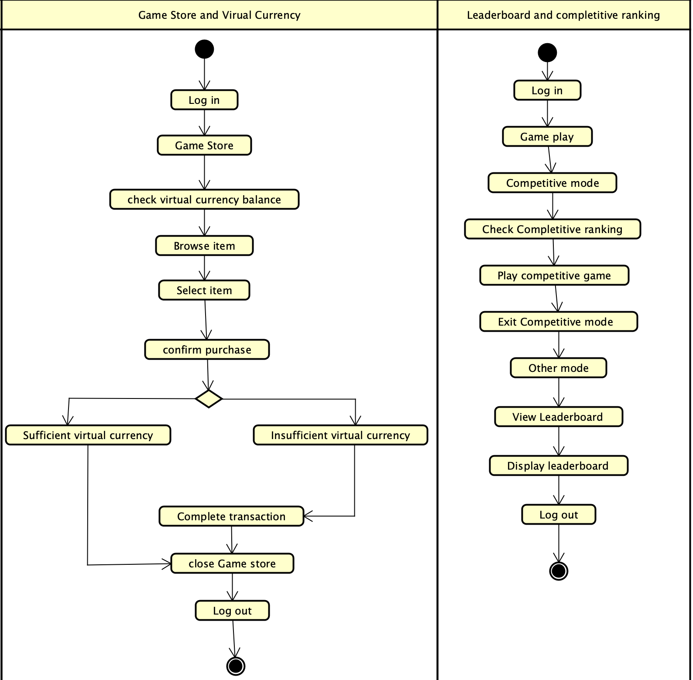
Activity diagrams

Slide 15
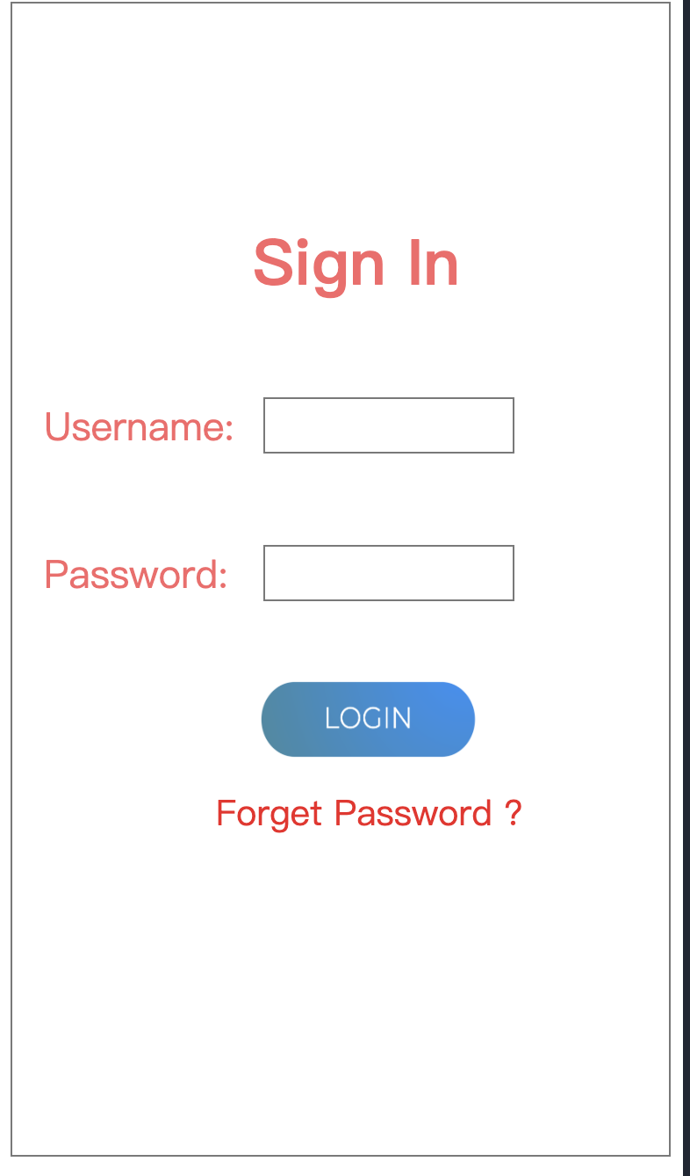
User interface design

Slide 16
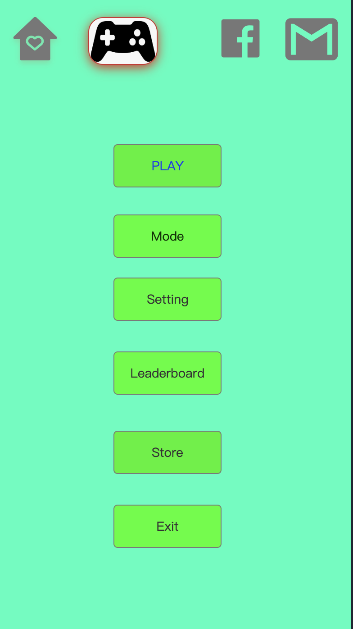

Slide 17
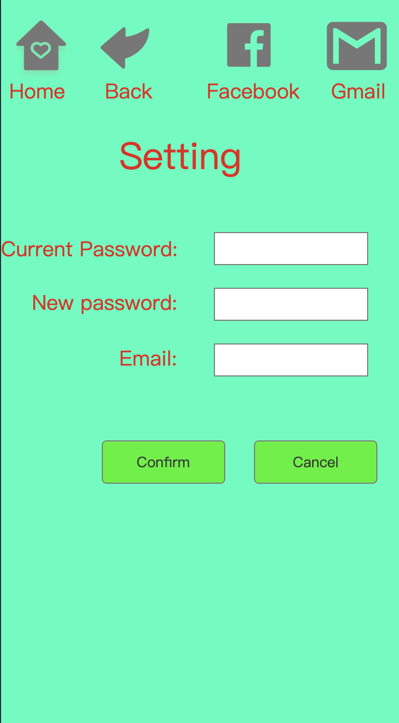

Slide 18
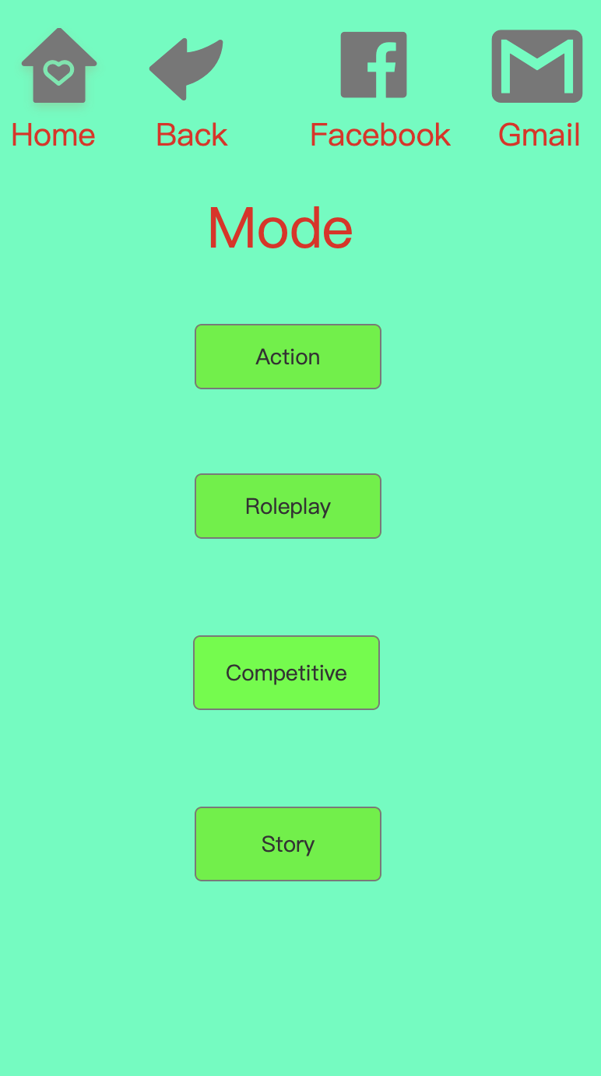

Slide 19
Conclusion
In conclusion, Valorant is a highly popular first-person tactical shooter game developed and published by Riot Games. It features a unique blend of traditional shooter gameplay and character-based abilities, where players take on the roles of agents with distinct skills and compete in 5v5 matches with objectives like planting or defusing a bomb. The game's focus on teamwork, strategy, and communication, along with its competitive esports scene and regular updates, has contributed to its widespread appeal and lasting success in the gaming community.

